Slide 1
Exam Platform Application
Sohan Kakatkar
VWITS Pune

Slide 2
Web Content Files
Index.jsp – Handles login activity of student and teacher
register.jsp – Handles registration of student and teacher
studenthome.jsp – Home page of student when successfully logged in
teacherhome.jsp – Home page of teacher when successfully logged in
Startexam.jsp - When the student logins, he/she can click on the start exam button which invokes startexam.jsp file which displays all the questions from database
ResultForTeacher.jsp – Displays the result of all candidates who appeared for exam
QuestionEdit.jsp – Allows teacher to fill a form to update existing questions
ProfileUpdate.jsp – Enables students to update their profile using a form

Slide 3
Controllers [ com.vwits.controllers ]
LoginServlet – Handles login of the users from login.jsp
LogoutServlet – Handles loging out of the users and invalidating the session.
RegisterServlet – Handles the registration of the users from the register.jsp
ProcessExamServlet – When student submits the exams, the checking of the correct answers and result calculation is achieved by this servlet.
InsertQuestionServlet – This servlet enables teacher to add a new question in the exam
QuestionEditServlet – This servlet enables teacher to edit an existing question in the exam
StudentProfileServlet – This servlet handles the updating of student profile by student

Slide 4
UTIL [Com.vwits.util]
MyDBConnection.java – This Java class handles all the database connectivity related operations

Slide 5
Data access object [ com.vwits.dao ]
UserLogin – Stores the user and this file connects to the database and inserts record successfully.
ResultDAO – Handles exam result and stores or update the score in DB
QuestionsDAO – Fetches all questions and their correct ans from DB

Slide 6
Model [ com.vwits.model ]
User.java – User class file with getters, setter, constructors, toString, etc.
Question.java – Question class file with getters, setter, constructors, toString, etc.
Result.java – Result class file with getters, setter, constructors, toString, etc.
ExaminationLogin.java – Handles all the user related activities like insert, update, etc.

Slide 7
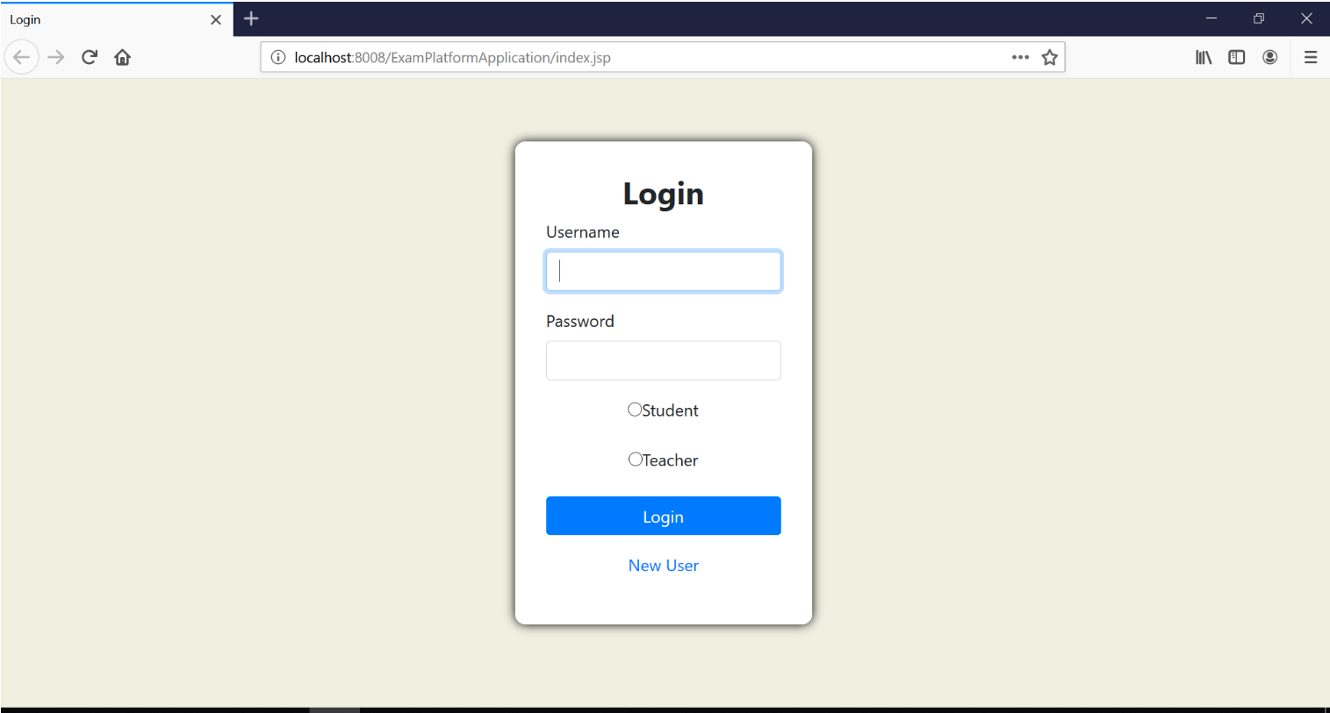
Login

Slide 8
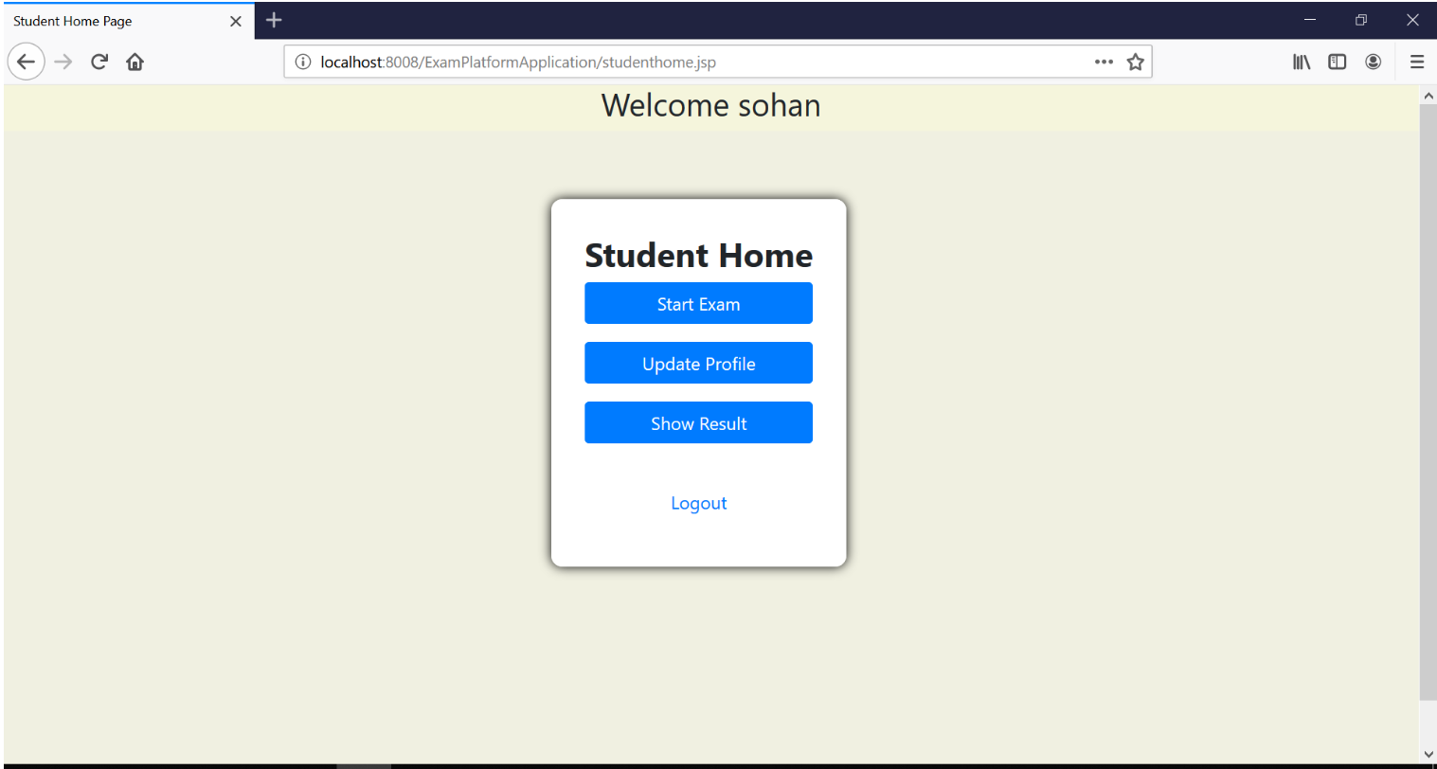
Student Home

Slide 9
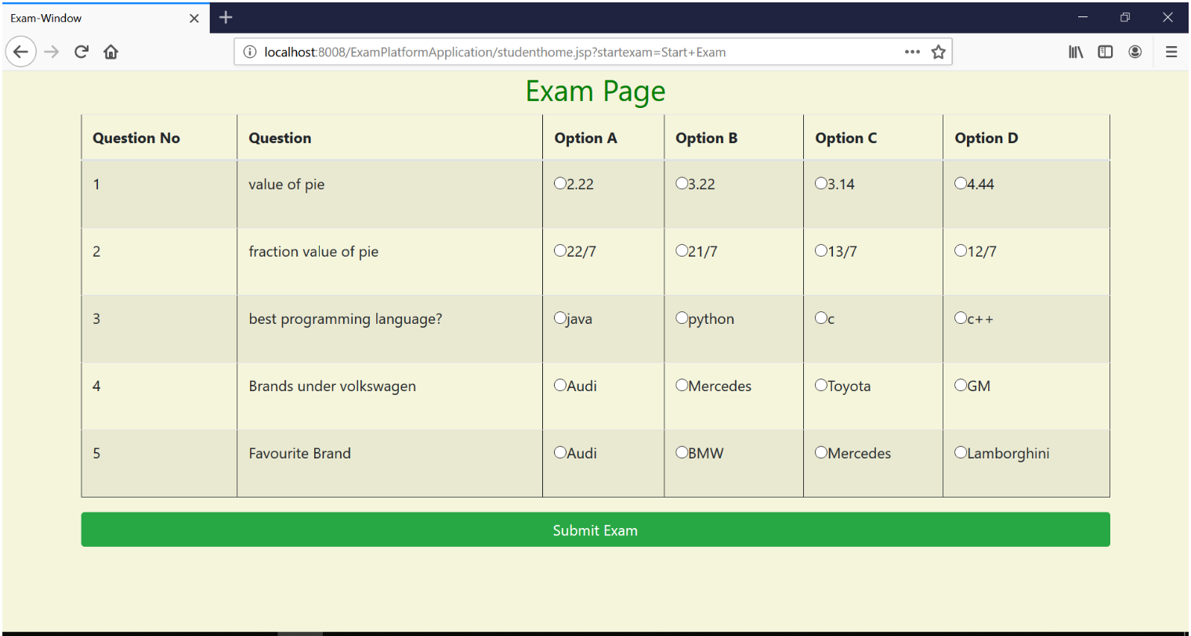
Exam Page

Slide 10
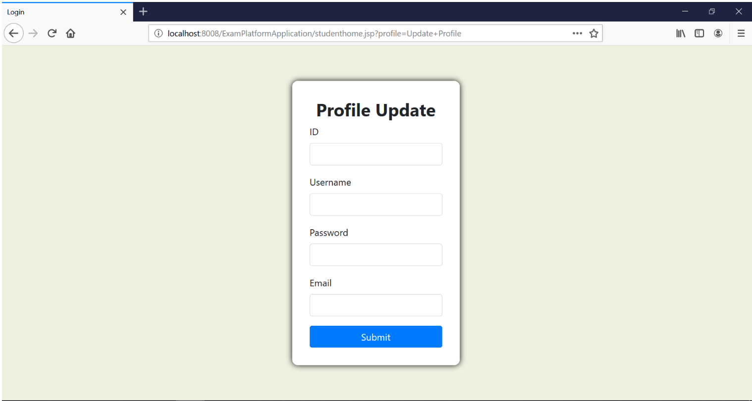
Student Profile Update

Slide 11
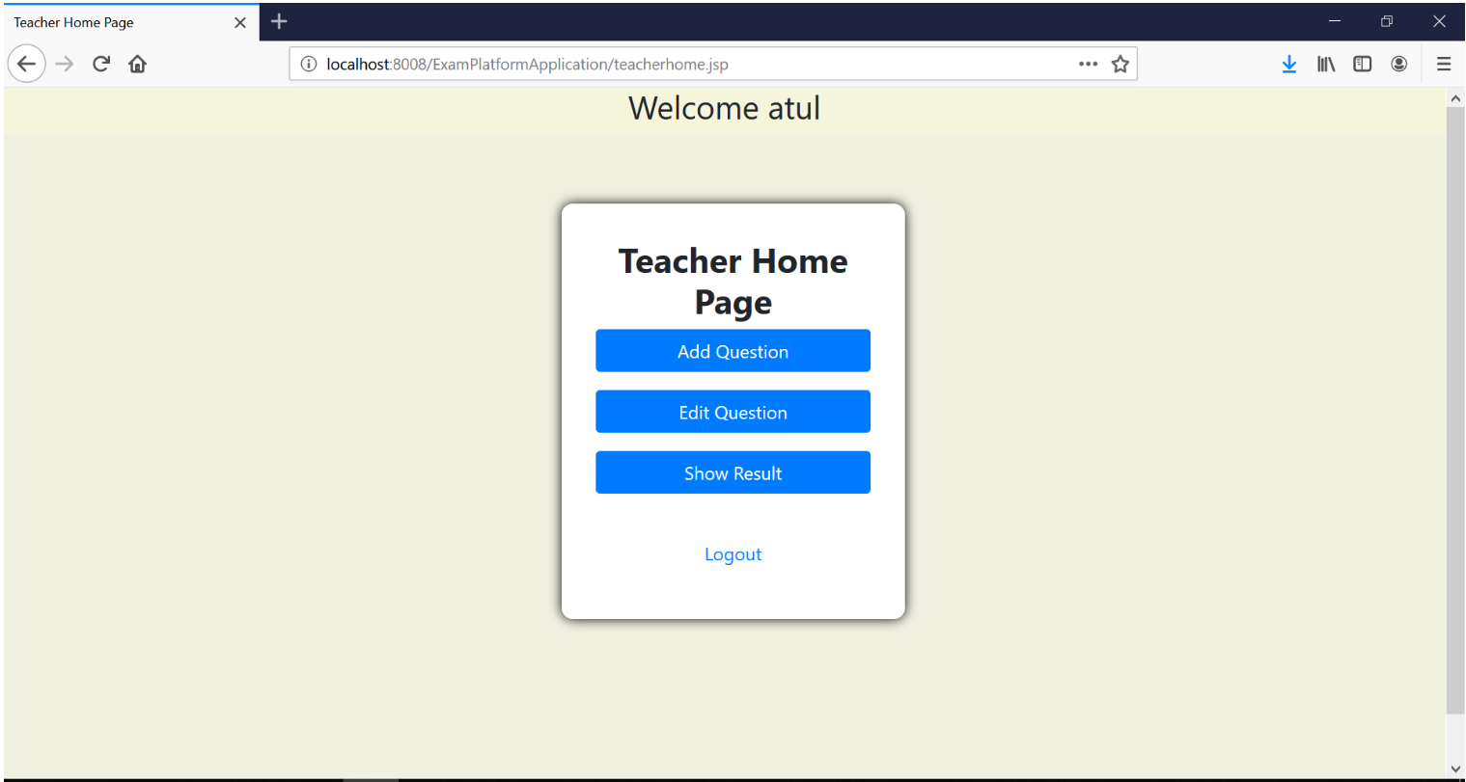
Teacher home page

Slide 12
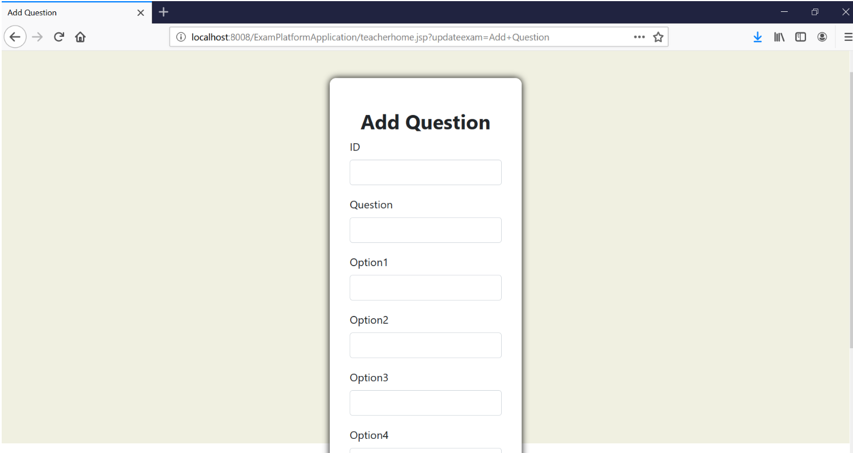
Add new Question

Slide 13
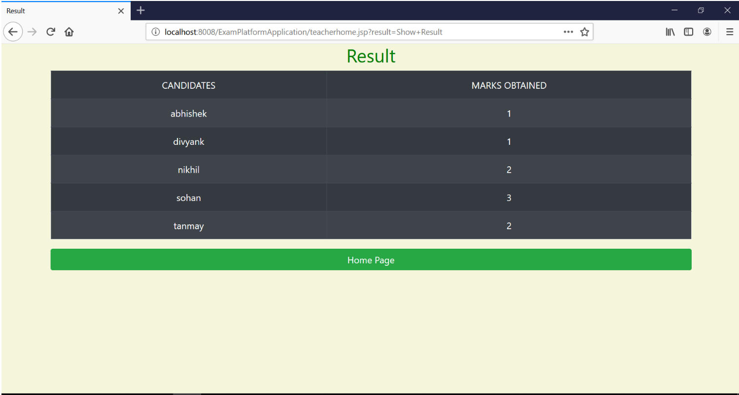
Display result

Slide 14
Thank you

